Slide 1
Spiritual Development in Seaver College Students
Academic Affairs Committee
Board of Regents
September 22, 2015
Cindy Miller-Perrin
Don Thompson
Notes:
This template can be used as a starter file for presenting training materials in a group setting.
Sections
Sections can help to organize your slides or facilitate collaboration between multiple authors. On the Home tab under Slides, click Section, and then click Add Section.
Notes
Use the Notes pane for delivery notes or to provide additional details for the audience. You can see these notes in Presenter View during your presentation.
Keep in mind the font size (important for accessibility, visibility, videotaping, and online production)
Coordinated colors
Pay particular attention to the graphs, charts, and text boxes.
Consider that attendees will print in black and white or grayscale. Run a test print to make sure your colors work when printed in pure black and white and grayscale.
Graphics, tables, and graphs
Keep it simple: If possible, use consistent, non-distracting styles and colors.
Label all graphs and tables.

Slide 2
The Sophomore Experience:
College as Rite of Passage
Rite of Passage
    Departure, Initiation, Return
Research Hypothesis & Measures
    Student vocational development is formed by the intersection of faith development, identity development, and spiritual barriers.
Longitudinal Design
    Three consecutive 4-year cohorts
    300 item survey, administered annually
    4000 undergraduate student participants

Slide 3
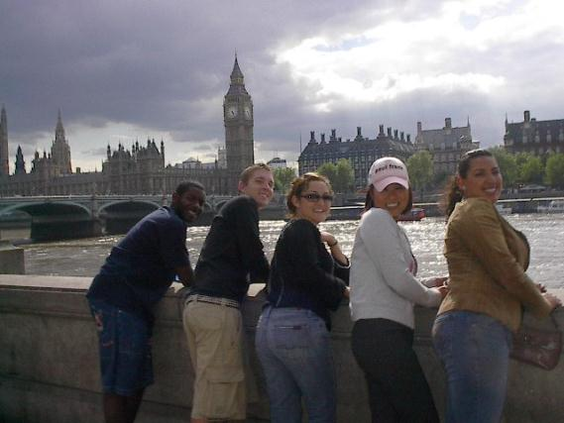
The Effects of Study Abroad on
Student Identity, Faith, and Vocation

Slide 4
Faith Attitude & Behavior Survey
Subscales | Sample Items
Strength of Beliefs (α = 0.73) | I view myself as a religious person I have doubts about whether my religious beliefs are true
Importance of Faith (α = 0.89) | Religion is not a very important part of my life right now My faith is not very important to me
Faith Behavior (α = 0.88) | How often do you attend religious services How often have you read a devotional, religious, or spiritual book in the last year

Slide 5
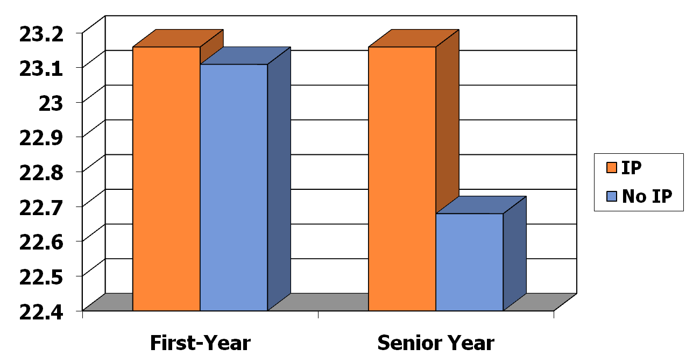
Strength of Belief Scores
First-Year and Senior Time Periods

Slide 6
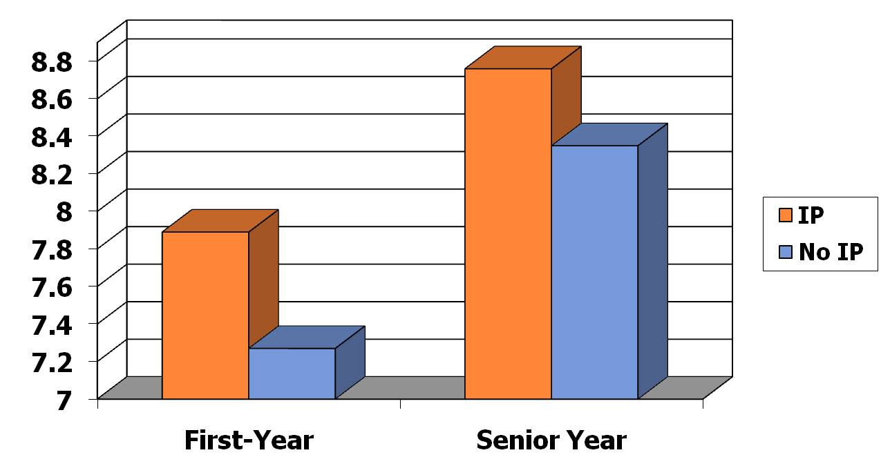
Faith Importance Scores
First-Year and Senior Time Periods

Slide 7
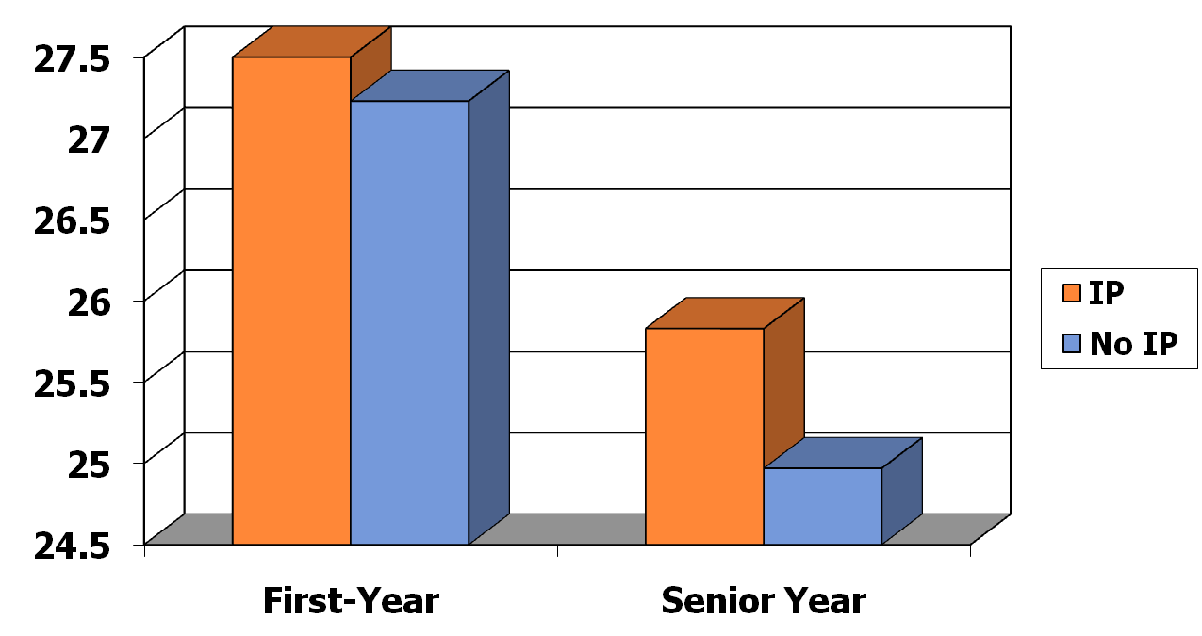
Faith Behavior Scores
First-Year and Senior Time Periods

Slide 8
Vocational Discernment and Action
Subscales | Sample Items
Discernment and Purpose (α = .76) | I have a good sense for my life purpose I know of the many ways that I can use my gifts and talents within the context of my professional career I am unsure about what God is specifically calling me to do
Service to Others (α = .68) | I am motivated to choose a career that will enable me to provide some type of service to others I feel a deep sense of responsibility for reducing pain and suffering in the world

Slide 9
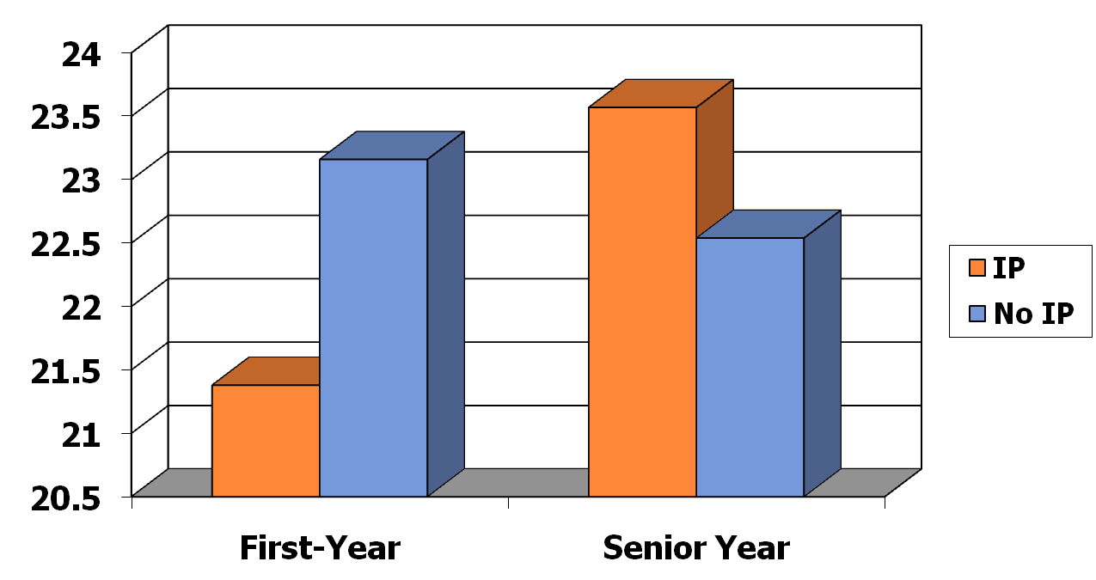
Discernment Scores
First-Year and Senior Time Periods

Slide 10
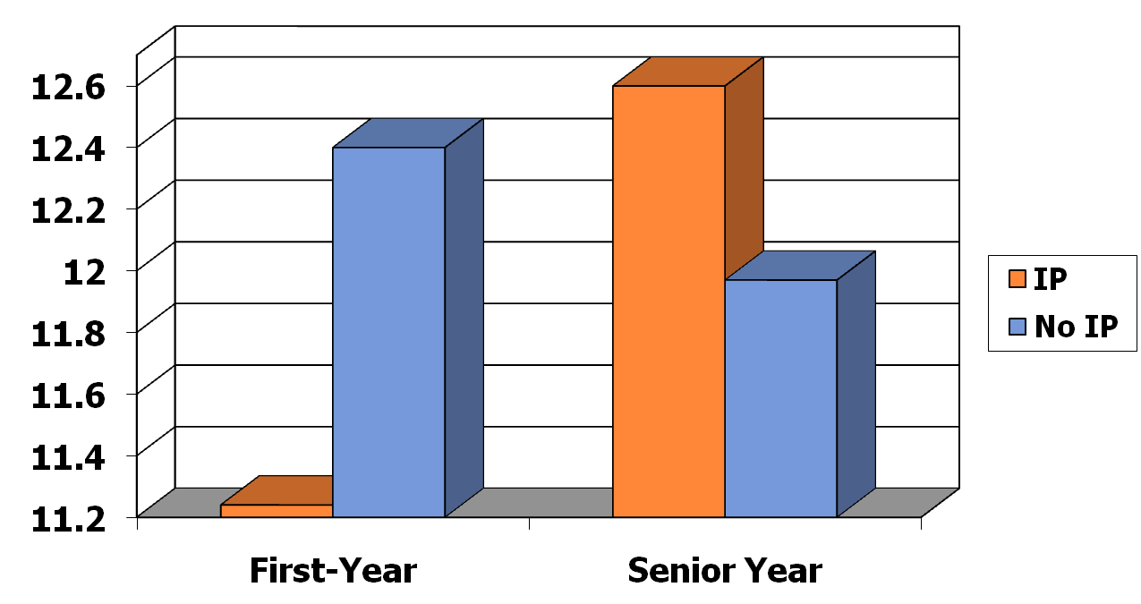
Service Scores
First-Year and Senior Time Periods

Slide 11
Sampling
Fall 2010 (Pre)
  880 students apply to study abroad in 2011-12
Spring 2012 (Mid)
  210 IP students re-survey
  116 NOIP students re-survey
Fall 2012 (Post)
  90 IP students re-survey
  32 NOIP students re-survey

Slide 12
Ego Identity Status Measure
12
  Diffusion: no exploration or commitment
    “I haven’t really considered politics. It just dosen’t excite me much.”
  Foreclosure: no exploration, but commitment
    “My parents decided a long time ago what I should go into for employment and I’m following through with their plans.”
  Moratorium: exploration without commitment
    “Religion is confusing to me right now. I keep changing my views on what is right and wrong for me.”
  Achievement: exploration and commitment
    “It took me a while to figure it out, but now I really know what I want for a career.”

Slide 13
Foreclosure ***
Notes:
13

Slide 14
Moratorium **
Notes:
14

Slide 15
Achievement **
Notes:
15

Slide 16
Global Awareness Measures
Empathy
  I have a duty to improve the world
  I enjoy spending time with people from other racial/ethnic/cultural groups
  I often think about how my personal decisions affect the welfare of others
Action
  I contribute money to international relief efforts
  I am involved with organizations that provide help for people in other countries
  I am one to speak up about racial injustice
16
Notes:
16

Slide 17
Empathy ***
Notes:
17

Slide 18
Factors Contributing to Growth Via International Programs
Travel
  Departure & Initiation
Mentoring
  Initiation
Community
  Initiation & Return

Slide 19
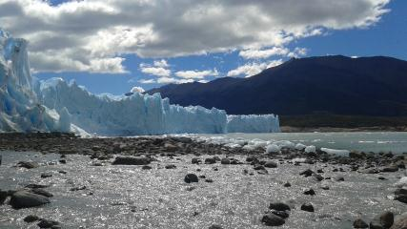
Travel
What has been the most spiritually challenging part of your International Program experience?
This has been the hardest but also the best year of my life. Living overseas forced me to either embrace or reject what I have believed all my life. It removed my safety nets.
I have grown through having to lean on God in almost every situation: from traveling to school to just living in a different culture, speaking another language.
My month long trip to Africa between semesters challenged my sense of self.
Traveling alone over Christmas Vacation showed me how to depend on the grace of God for support.
A person I met in Greece helped me realize my selfishness, making me want to be more generous.

Slide 20
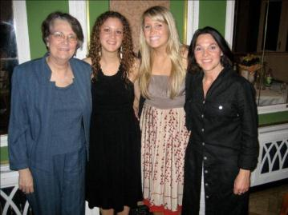
Mentoring
Who has been most instrumental in helping you grow spiritually? Why?
One of the other students in the program made me challenge myself and helped me grow spiritually.
The host family impacted me the most because we are in worship with them and they are the leaders that we look up to in the house.
When I felt weak, my faculty “mom” knew and was someone that would come up to me and ask what was wrong. She would help me understand and trust in God.
The host family made me feel at home and always made time to check on me and how I was doing.
The program assistant had a great impact on me spiritually this semester through her incredible yet humble display of faith. She is such an inspirational woman of God.

Slide 21
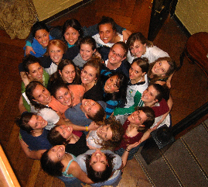
Community
How has the community of the international program experience enhanced your spiritual growth?
Our weekly, student led Bible studies & student run worship have had the greatest spiritual impact on me.
Women's small group and student-led worship were an AMAZING support system. The best community I've ever had. This is my home away from home.
The guys’ small group was a time where we could be open and honest.
I have grown more here in my spirituality than I did at home and all of that growth was due to other students.
Simply by living with and engaging with such incredible individuals, who have not only helped me through difficult times, but who have encouraged me to seek God more, I've experienced a growth in spirituality.

Slide 22
Conclusions & Recommendations
Sophomores Experience Dramatic Spiritual Change
  International living and learning experiences facilitate greater growth in faith, sense of life purpose, and identity
  Significant opportunities for personal growth occur when students leave their cultural comfort zone and rely on communities with mentoring support
Spiritual Challenge is unavoidable and desirable
Faculty/Staff Preparation & Community
Mentor-Protégé Relationship – Key to Initiation and Return
Use the Vocation/Life-Purpose Lens to Deepen Faith Development
Connect with Alumni & Their Faith Development

Slide 23
Don Thompson thompson@pepperdine.edu
Cindy Miller-Perrin cperrin@pepperdine.edu

